Slide 1
Final Project
Data Science Course
SMART
ATTENDANCE
SYSTEM
Face Recognition

Slide 2
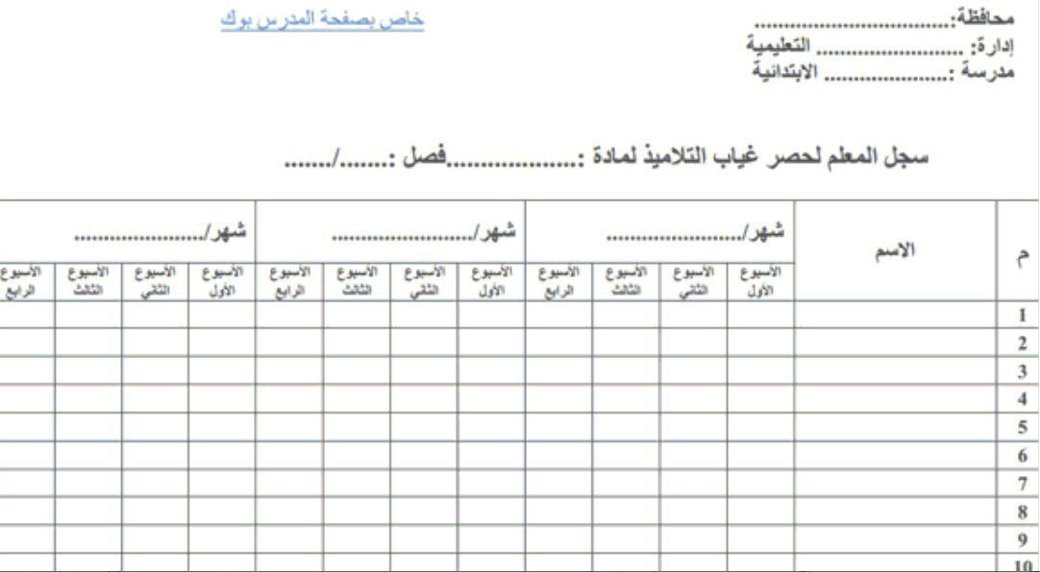

Slide 3
The Problem — Why This Matters
Teachers struggle every day with manual attendance. It wastes time and causes mistakes.
❌ Writing names by hand takes 5-10 minutes every class
❌ Easy to make mistakes — wrong name or missed student
❌ No way to know if a student is awake or sleeping
❌ Parents are not notified when their child is absent
❌ No digital record — paper lists get lost easily

Slide 4
Goals — Why Did We Build This?
Manual attendance is slow and error-prone. Parents don't know when their child is absent.
Automatically identify students using the camera
Record attendance — Present, Late, or Absent — with exact time
Detect if a student is Active or Sleepy during the session
Email parents automatically when their child is absent
Save a full Excel report for the teacher

Slide 5
Success Criteria & Metrics
70%
Model Accuracy
Correctly identifies students on unseen data
A win = runs in real time, recognizes students, and exports a clean Excel report.

Slide 6
Data — Source, Quality & Preprocessing
Training Data (Faces Folder)
Large celebrity face dataset
Student Data (Students.xlsx)
Many images per person
Name, Phone, Parent Email, Image Path
Teaches CNN how faces look
Added from Streamlit app
70% train · 15% val · 15% test
One photo minimum per student
Easy to update in Excel

Slide 7
How Does It Work?
1. CNN — Learn Faces
2. Feature Extraction — Face to Numbers
We trained a CNN model on face images. It learns what makes each face unique.
We remove the last layer. Now the model turns any face into 128 numbers — like a fingerprint.
3. Cosine Similarity — Find the Match
We compare the 128 numbers from the camera with each student. Closest match = that student!

Slide 8
Findings — What Did the Data Tell Us?
Feature Extraction > Direct Prediction
More photos = better accuracy
Model recognized faces it never saw during training.
Students with multiple photos were recognized more reliably.
Drowsiness works best in good lighting
Eye detection needs student facing camera directly.

Slide 9
Risks & Limitations — Being Honest
⚠️ 70% accuracy — not perfect
💡 Lighting matters a lot
1 in 4 may be wrong. More photos help.
Poor light reduces detection quality.
👓 Appearance changes
📸 One photo per student
Glasses or hats may affect results.
More photos = better recognition.
🔁 Retraining needed
🖥️ Streamlit UI blocks
Must re-run for new students.
Known OpenCV + Streamlit limitation.

Slide 10
THANK YOU!
Smart Attendance System

Slide 11
Try It
Live!
Streamlit

